Slide 1


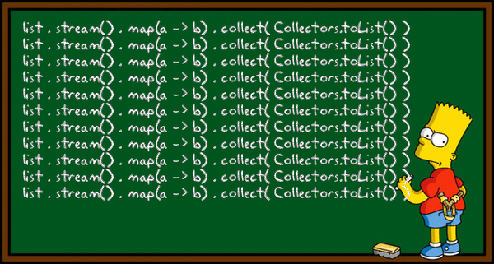

Functional Programming and Stream API
Functional Interfaces, Lambda Expressions
SoftUni Team
Java
Technical Trainers
Software University
http://softuni.bg

Slide 2

Table of Contents
What is Functional Programming
Functional Interfaces in Java 8
Predicate <T>
Function <T, R>
Stream API

Slide 3

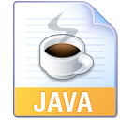
Warning: Not for Absolute Beginners
The "Java Fundamentals" course is NOT for absolute beginners
Take the "C# Basics" course at SoftUni first: https://softuni.bg/courses/csharp-basics
The course is for beginners, but with previous coding skills
Requirements
Coding skills – entry level
Computer English – entry level
Logical thinking
coding skills
required!

Slide 4
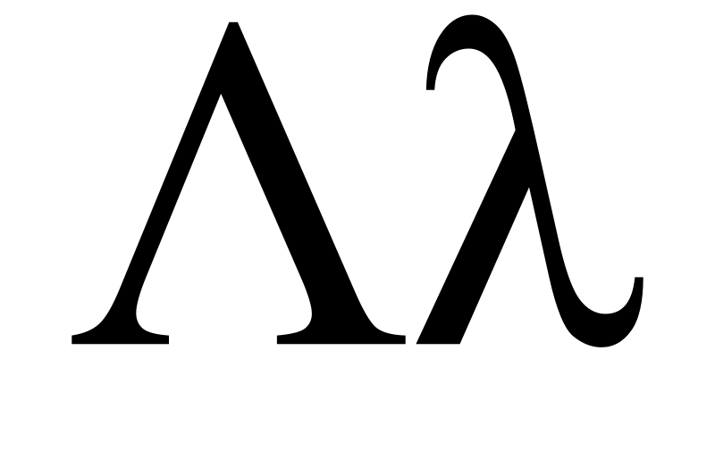
Functional Programming
Basic Concepts

Slide 5
What is Functional Programming?
Functional programming is a programming paradigm
Uses computations of mathematical functions to build programs
Declarative programming paradigm (not imperative)
Uses first-class functions, higher-order functions, lambda functions, anonymous functions, closures, etc.
Pure-functional languages (no variables and loops): Haskell
Almost-functional: Clojure, Lisp, Scheme, Scala, F#, JavaScript
Imperative with functional support: C#, Python, Ruby, PHP, Java
Non-functional: C, Pascal, the old versions of C#, Java, C++, PHP

Slide 6
Functions in Functional Programming
First-class functions
Variables holding functions as a value
Higher-order functions
Functions taking other functions as input (Stream API in Java)
Оr returning a function as output
Closures
Nested functions hold (close) persistent state in their outer scope
Allow creating objects with private fields in functional languages

Slide 7
Functional vs. Imperative Programming
Functional programming
Program by invoking sequences of functions
Imperative programming
Describe the algorithm by programming constructs
int[] nums = {1, 2, 3, 4, 5}; Arrays.stream(nums)
.forEach(e -> {
System.out.println(e);
});
// or
Arrays.stream(nums) .forEach(System.out::println);
int[] nums = {1, 2, 3, 4, 5};
for (int num : nums) {
System.out.println(num);
}

Slide 8
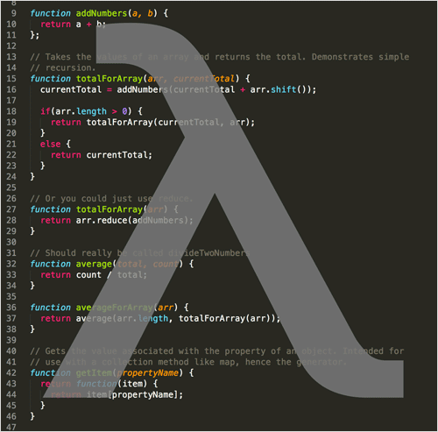
Predicate <T>
Boolean-value functions

Slide 9
Predicate <T> Interface
Statement that may be true or false
Depends on the value of its variables
Functional interface available since Java 8
Usually assigned a lambda expression or method reference
Usefull when a collection of similar objects needs to be evaluated by a specific criteria

Slide 10
Predicate <T> Example
public static Predicate<Integer> isEven() { return p -> p % 2 == 0; }
public static void main(String[] args) { List<Integer> nums = Arrays.asList(1, 2, 3, 4, 5); for (int num : nums) { if (isEven().test(num)) { System.out.print(num + " "); } }
}
// outputs 2 4 // Example continues

Slide 11
Predicate <T> Example (2)
More easily used with the Java 8 Stream API
public static void main(String[] args) { List<Integer> nums = Arrays.asList(1, 2, 3, 4, 5);
nums.stream()
.filter(isEven().negate())
.forEach(System.out::println);
}
// 1
// 3
// 5

Slide 12
Predicate <T> Benefits
Frequently used conditions are moved to a central place
Can be unit-tested easily
Readable and self-documenting code
Makes it easier for other programmers to follow the logic of your application
Changes need not be duplicated in multiple places
Your application is easier to maintain

Slide 13
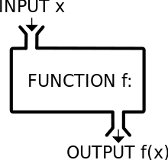
Function <T, R>
Reusing Common Actions

Slide 14
Function <T, R> Interface
Similar to Predicate<T>
Can return any type
Can also be assigned a lambda expression or method reference
Usefull when a collection needs to be transformed
Usually with stream().map()

Slide 15
Function <T, R> Example
Map a collection of string to a collection of integers
public static Function<String, Integer> parseInteger() { return p -> Integer.parseInt(p); } public static void main(String[] args) { List<String> numbers = Arrays.asList("1", "2", "3", "4", "5"); List<Integer> parsedNumbers = numbers.stream() .map(parseInteger()) .collect(Collectors.toList()); }

Slide 16
Function <T, R> Example (2)
Can be targeted by a lambda expression
public static String modifyString(String s, Function<String, String> function) { return function.apply(s); } public static void main(String[] args) { String hardUni = modifyString("SoftUni", s -> s.replace("Soft", "Hard"));
// HardUni String soft = modifyString("SoftUni", s -> s.substring(0, 4));
// Soft String uppercased = modifyString("SoftUni", String::toUpperCase);
// SOFTUNI }

Slide 17
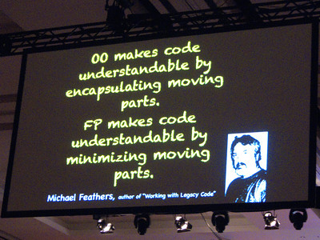
Stream API
Functional Approach

Slide 18
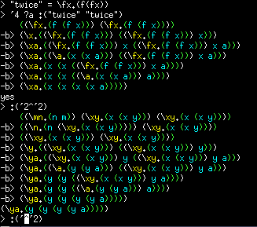
Collection Querying and Traversing (1)
Querying a collection is possible in a functional way
Methods are chained returning a new query instance
A terminal method is executed at the end
This is all possible via the Stream API available from Java 8

Slide 19
Collection Querying and Traversing (2)
Intermediate methods
distinct() – removes non-unique elements
filter(Predicate<T>) – filters elements (Where in LINQ)
flatMap(Function<T, Stream>) – transforms one Stream to another Stream. May contain different type of elements
limit(long) – limits the elements in the new Stream
map(Function<T, R>) – flatMap() without different types. Same as Select in LINQ
sorted(Comparator?) – sorts the elements in the Stream

Slide 20
Collection Querying and Traversing (3)
Terminal methods
allMatch(Predicate<T>) – checks whether all elements in the Stream meets the predicate criteria (boolean)
anyMatch(<Predicate<T>) – checks whether at least one element in the Stream meets the predicate criteria (boolean)
collect(Collector<T, A, R>) – converts a Stream to a materialized collection (List, Map, Set…)
findAny() – returns an element from the Stream. Returns Optional<T> (same as Nullable<T> in C#)

Slide 21
Collection Querying and Traversing (4)
Terminal methods (1)
findFirst() – returns the first element from the Stream
forEach(Consumer<T>) – executes the consumer implementation upon each element. Void one.
forEachOrdered(Consumer<T>) – same as above but the elements are ordered. Not thread-safe
max(Comparator<T>) – returns the maximum element by a given criteria wrapped in Optional<T>

Slide 22
Collection Querying and Traversing (5)
List<String> names = new ArrayList<>(); names.stream() .filter(n -> n.length() > 8) .forEach(System.out::println); Optional<String> first = names.stream() .findFirst(); System.out.println(first.get());

Slide 23
Collection Querying and Traversing (6)
LinkedHashMap<String, LinkedHashMap<String, Integer>> venues = new LinkedHashMap<>(); venues.entrySet().stream().forEach(entry -> { entry.getValue().entrySet().stream().sorted((innerEntry1, innerEntry2) -> { return Integer.compare(innerEntry1.getValue(), innerEntry2.getValue()); }).forEach(innerEntry -> { System.out.println(innerEntry.getKey()); System.out.println("-----------"); System.out.println(innerEntry.getValue()); }); });

Slide 24
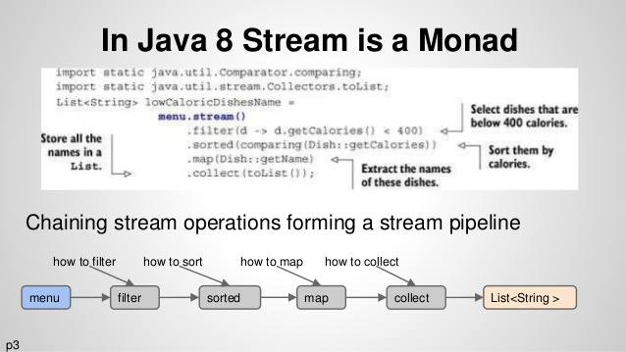
Future References
Monads with Java 8 Stream (Bulgarian)
http://www.cphpvb.net/java/9650-monads-with-java-8-stream/

Slide 25
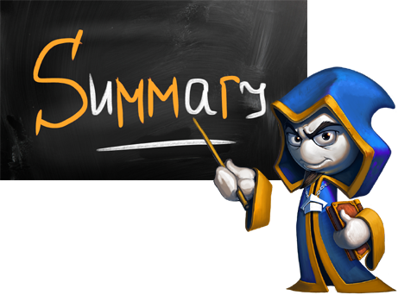
Summary
Functional Interfaces and Stream API
Predicate <T>
Function <T, R>
Streams
filter(), map(), sorted(),
distinct(), anyMatch(), allMatch()
forEach() …

Slide 26








Functional Interfaces and Stream API
https://softuni.bg/courses/java-basics/

Slide 27
License
This course (slides, examples, demos, videos, homework, etc.) is licensed under the "Creative Commons Attribution-NonCommercial-ShareAlike 4.0 International" license
Attribution: this work may contain portions from
"Fundamentals of Computer Programming with Java" book by Svetlin Nakov & Co. under CC-BY-SA license
"C# Basics" course by Software University under CC-BY-NC-SA license

Slide 28






Free Trainings @ Software University
Software University Foundation – softuni.org
Software University – High-Quality Education, Profession and Job for Software Developers
softuni.bg
Software University @ Facebook
facebook.com/SoftwareUniversity
Software University @ YouTube
youtube.com/SoftwareUniversity
Software University Forums – forum.softuni.bg

